Slide 1
Segmentation (High level quick revision)

Slide 2
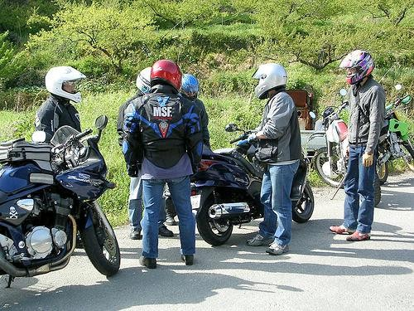
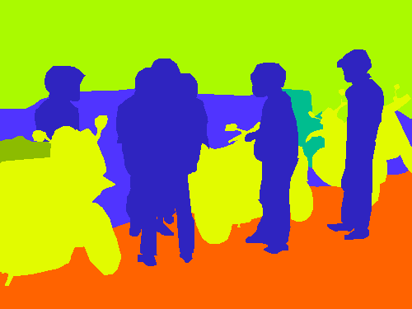
The Task
person grass trees motorbike road

Slide 3
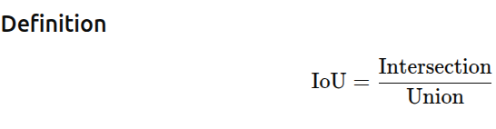
Evaluation Metrics in Segmentation:
How good is our pixel-wise prediction?
1. Pixel Classification Think of segmentation as:→ A classification problem at pixel level
Example:
Pixel 1 → road
Pixel 2 → car
Pixel 3 → background
So instead of classifying one image, we classify thousands/millions of pixels
2.Intersection over Union (IoU) Meaning
Intersection → Correct prediction (overlap)
Union → Total area covered by prediction + ground truth
We cannot use direct accuracy formula like Accuracy=correct pixels/total pixels it will create big problem. In real images:Background pixels → very large (e.g., 90%),Object pixels → very small (e.g., 10%)
Model predicts:Everything as background Then:Accuracy = 90% ,But model is useless

Slide 4
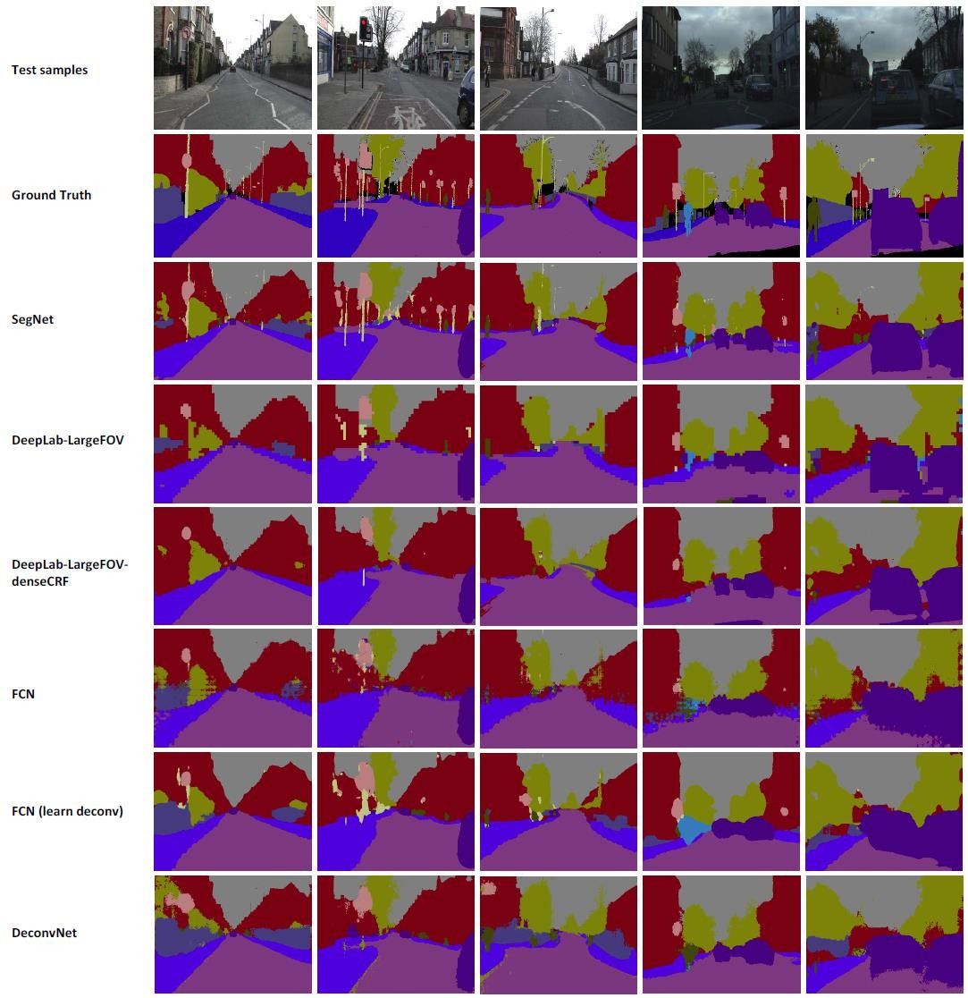
FCN (Fully Convolutional Network): Look closely at the FCN row. You’ll notice the edges look a bit "blocky" or blurry compared to the Ground Truth. FCN was a pioneer, but it often struggles with fine details.
DeepLab-LargeFOV-denseCRF: Notice how this one looks much "sharper" than the standard FCN. The CRF (Conditional Random Field) is a post-processing trick used to clean up the edges and make the shapes look more like real objects.
SegNet & DeconvNet: These models use "Encoder-Decoder" structures. They try to capture the big picture (Encoder) and then carefully reconstruct the fine details (Decoder).

Slide 5
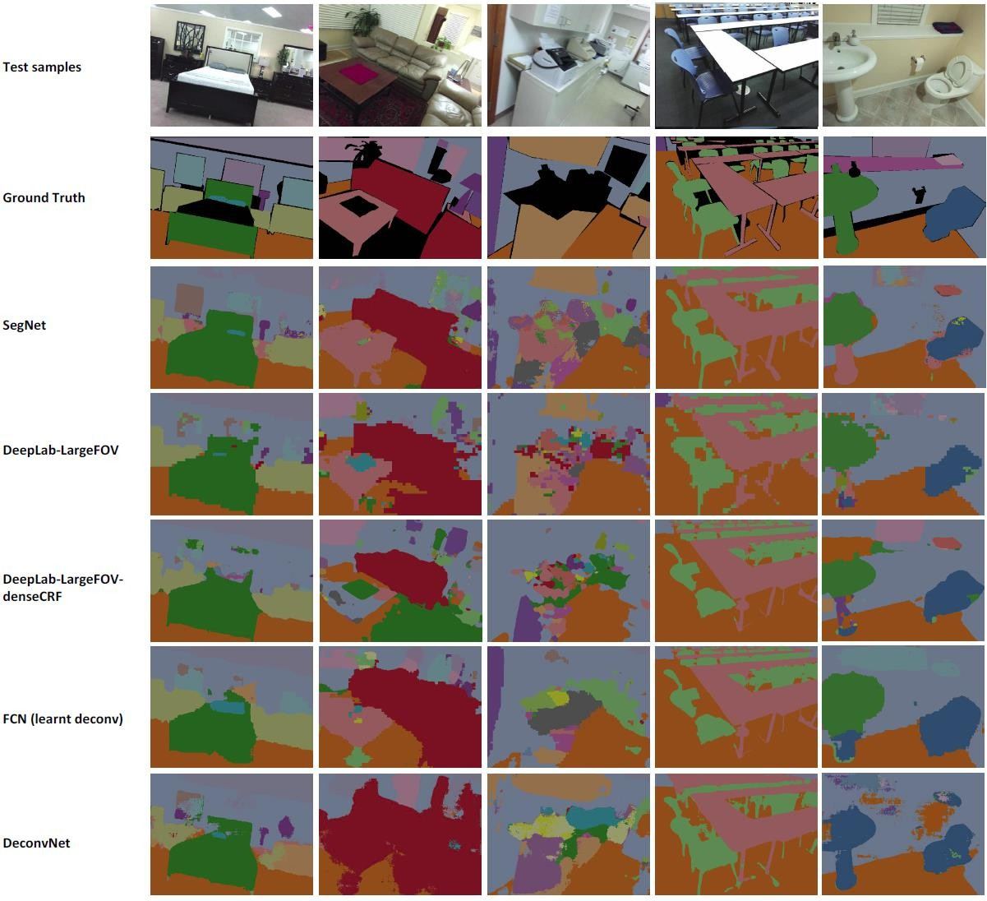

Slide 6
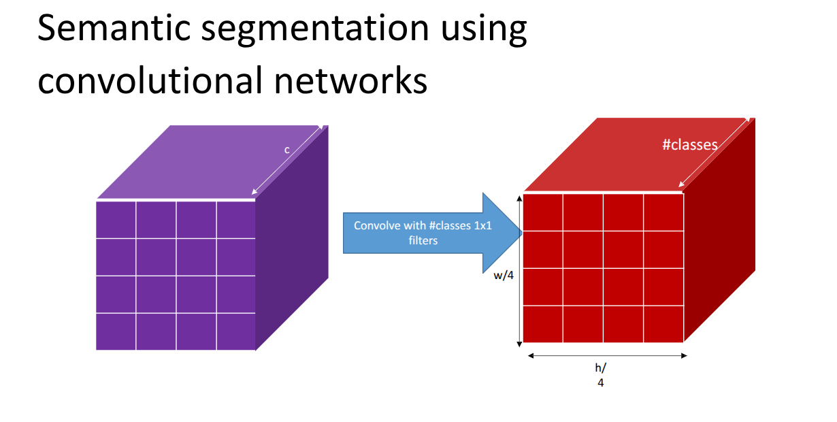
By using a 1 x 1 convolution:
We are looking at each "pixel" location across all c channels.
We shrink the depth from c down to the exact number of categories
Each "slice" of this block is like a heat map for a specific class.

Slide 7
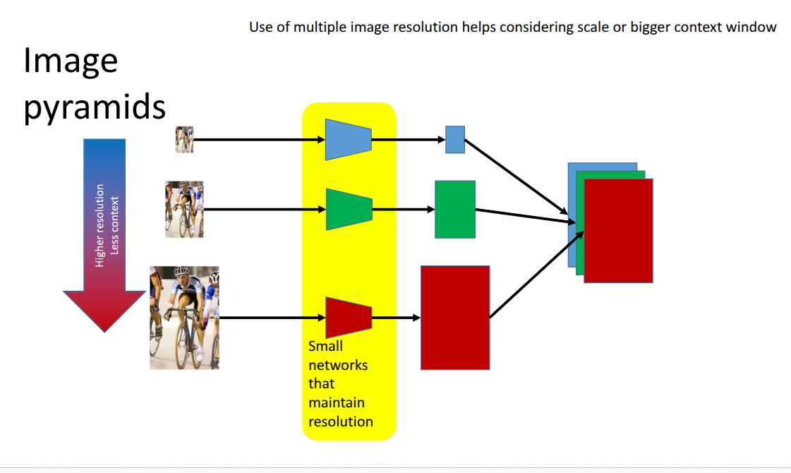
Small image → sees whole scene
Large image → sees fine details
Top (small image)
Sees entire scene
Learns:
Global structure
Object relationships
🟩 Middle (medium image)
Balanced view
Learns:
Mid-level features
🟥 Bottom (large image)
Zoomed-in view
Learns:
Edges
Fine details
Each image scale is passed through a separate CNN
All outputs are:Combined (fused together)

Slide 8
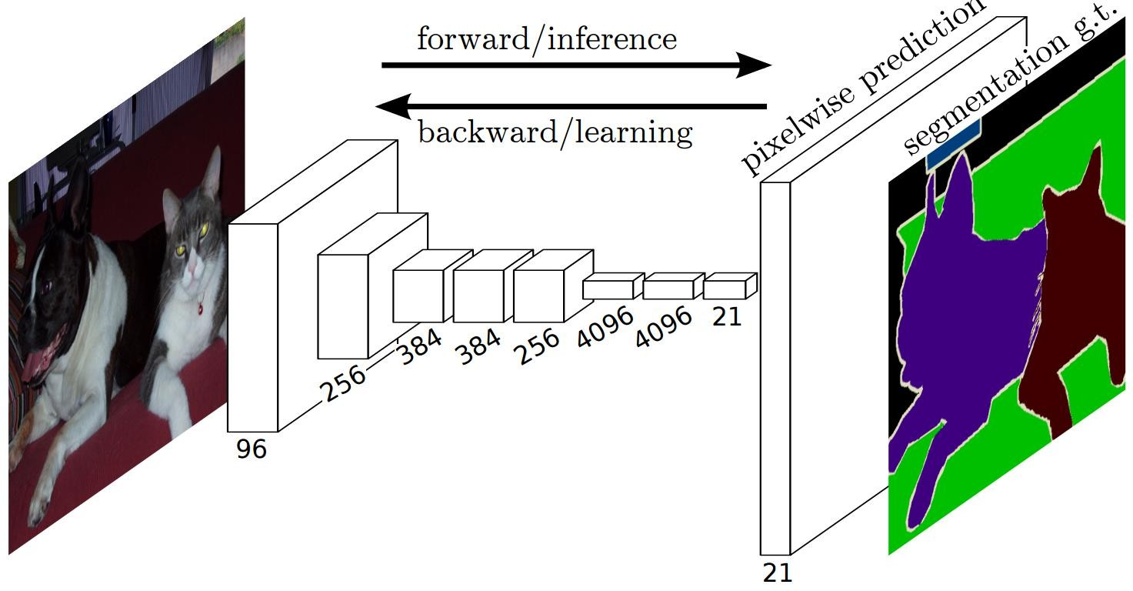
Image segmentation FCN
Looking at the blocks in the middle, you see the numbers (96, 256, 384, etc.). These represent the number of filters (depth). Notice how the blocks get physically smaller in height and width but deeper in thickness.
See that last thin block with the number 21?This matches the PASCAL VOC dataset, which has 20 object classes + 1 background class.

Slide 9
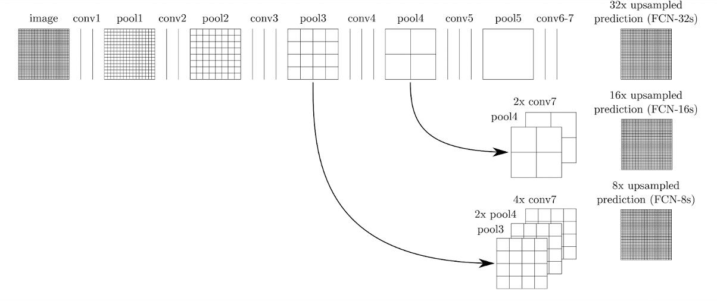
Combining responses from multiple layers

Slide 10
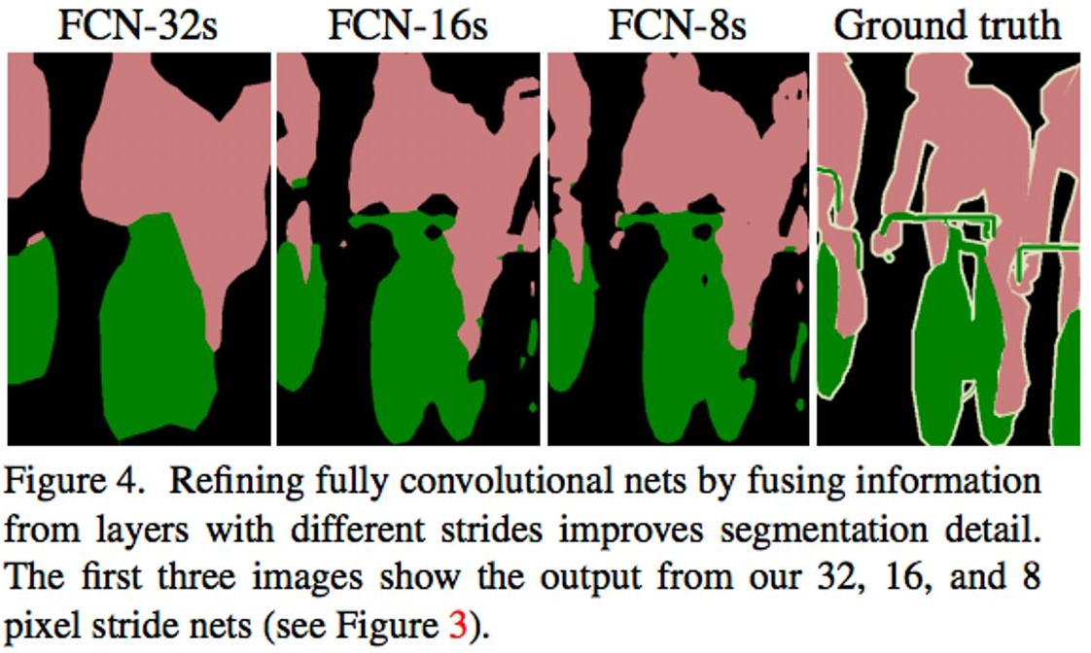

Slide 11
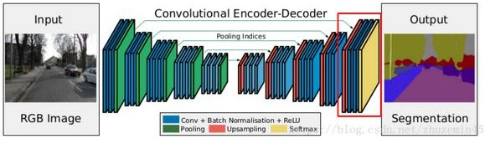
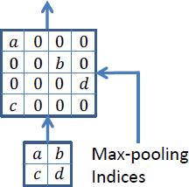
Image segmentation - segnet
SegNet is an encoder–decoder architecture for segmentation Main idea:“Downsample using pooling in encoder, and use those same pooling locations to upsample in decoder.”
SegNet does:Unpooling using stored indices
Important Instead of just keeping values, SegNet keeps:“Where the max came from” This is called: Pooling indices

Slide 12
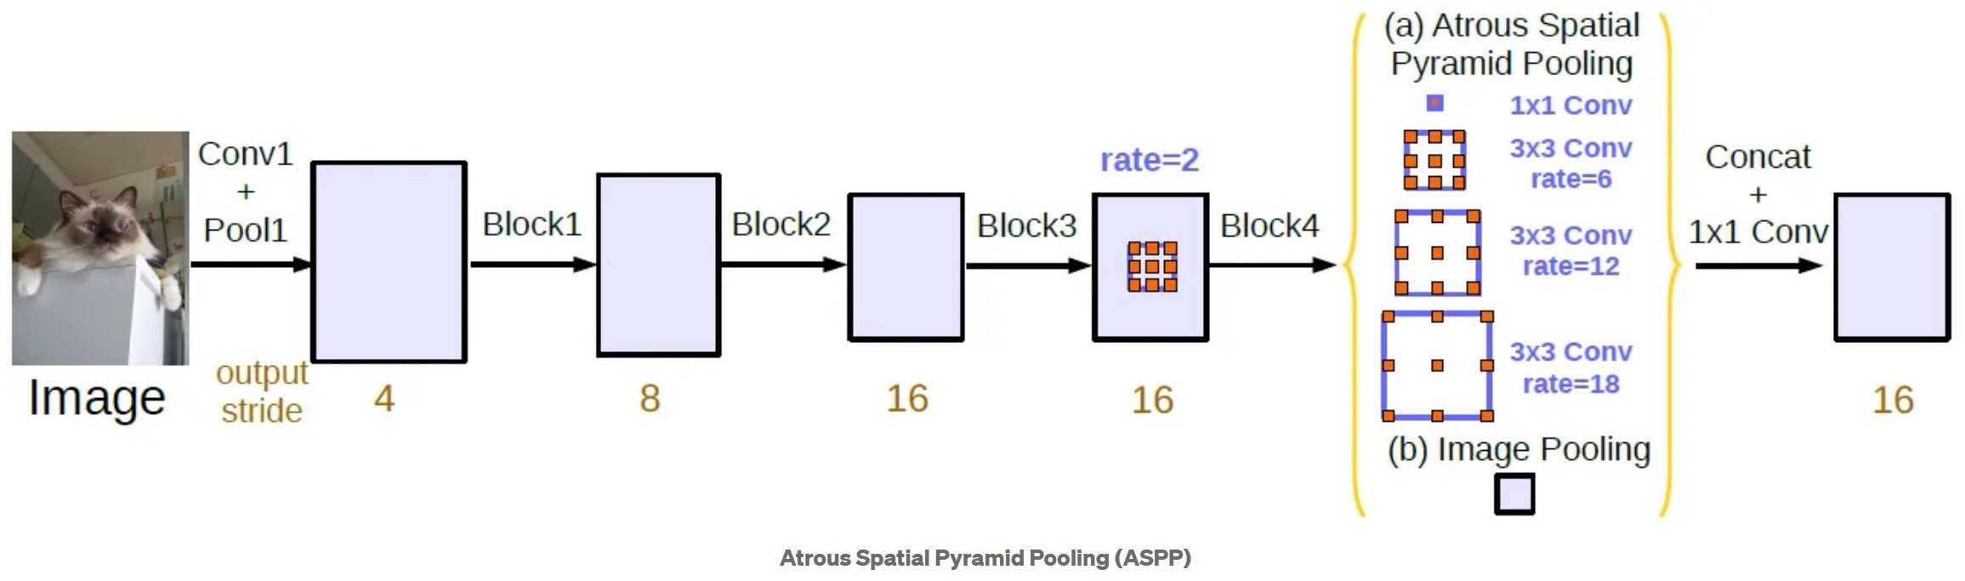
Deeplab V3:
Deeplab idea :The core idea is:“Use a CNN to get coarse segmentation, then refine it using upsampling and CRF to get sharp boundaries.”
DeepLabV2 → added atrous conv
DeepLabV3 → ASPP (no CRF)
DeepLabV3+ → added decoder

Slide 13
Thank you

